Slide 1

INTERNSHIP PRESENTATION
CST318

Slide 2

This report is being presented as part of CST318 course to describe the details of the Internship done as part of the Summer Internship Process of the DKTE’s
TEI Ichalkaranji.
Abstract
Name PRN
1.Vrushali Magdum 18UCS061
2.Neha Mahajan 18UCS063
3.Vaishnavi Mankapure 18UCS065
4.Sumati Murgunde 18UCS069
5.Shreya Patil 18UCS082

Slide 3

Internship at PHN Technology Pvt . Ltd. Pune.
About the company:
Established in the year 2013, PHN Technology Pvt Ltd in Dhankawadi, Pune is a top player in the category Computer
Training Institutes in the Pune. Created with vision to offer high quality training services to individuals and the corporates
in the field of Computer infrastructure management. It is known to provide certification courses top service in the
following categories: ‘Computer Training Institutes’, ‘Digital Marketing Training Institutes’, ‘Computer Training Institutes
For Java’, ‘Computer Training Institutes For Python’, ‘Computer Training Institutes For Machine Learning’ ,
‘Computer Training Institutes For Web Technology’, ‘Robotics’, ‘Computer Software Training Institutes’,
‘Computer Training Institutes For C Programming’, ‘ Website Development’, ‘Software Development’,
‘ Android Development’ .

Slide 4


Company Division:
The company has two divisions:
1. Training Division
2.Project Handling Division
The training division gives training of various aspects regarding Python
And Machine Learning services. The other division viz. Project handling
division takes big project to complete and also to the real-time
data analysis.

Slide 5




Tools Used:
1.Visual studio management
system 2015
2.XAMPP App
3.Nodejs
4.Sublime text editor

Slide 6
Working Methodology:
We were supposed to work on the Sublime Text Editor and Visual Studio code for coding purpose.
Sublime Text and VSCode are the most popular code editors available right now. It is adored by many programmers for it's speed, simplicity, and rich plugin ecosystem. All my work has to be saved there.
They used to give me some problems as a classwork and some as homework. That was helpful to improve our skills and confidence. Also they took our practise test to check our progress.
We were there for internship in web technology including languages like HTML, CSS, PHP, JavaScript,Bootstrap,AngularJs,Angular,Laravel.

Slide 7
About the Projects:
We were required to work on the sublime text editor and VSCode .Our projects were based on the web development and creating various websites, web pages.we completed
our projects Using
HTML
CSS
Bootstrap
Javascript
PHP
Angular.js
Angular

Slide 8
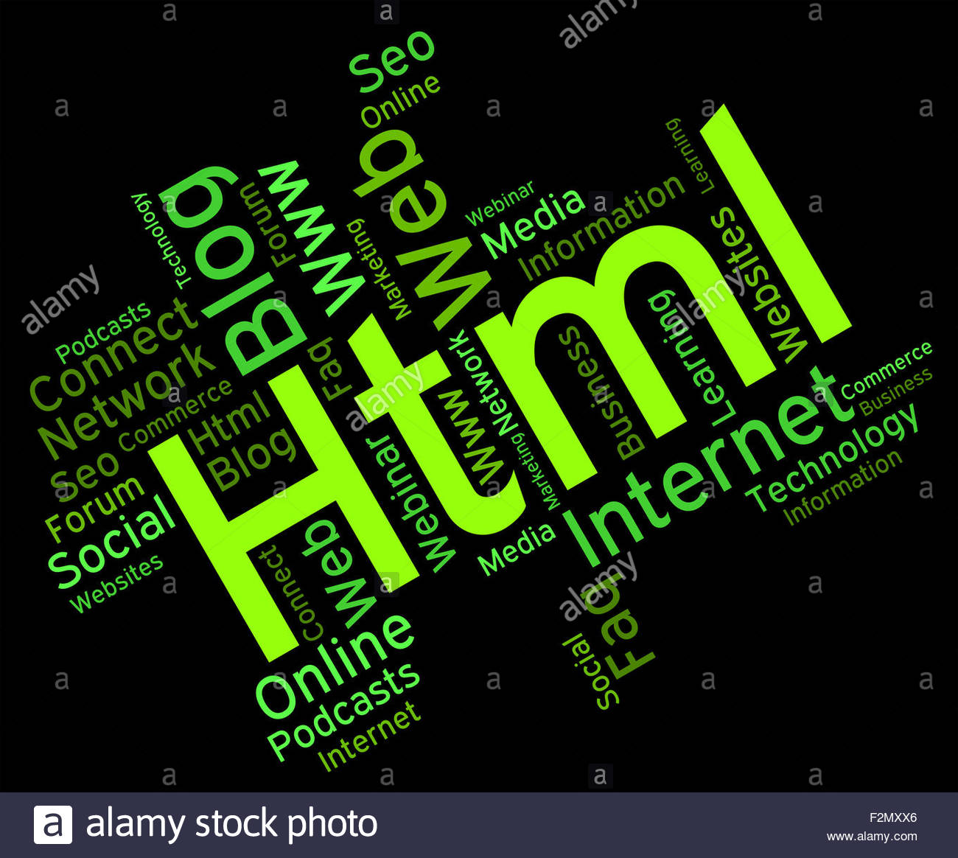
What is HTML?
HTML stands for Hyper Text Markup Language
HTML is the standard markup language for creating Web pages
HTML describes the structure of a Web page
HTML consists of a series of elements
HTML elements tell the browser how to display the content
HTML elements label pieces of content such as "this is a heading", "this is a paragraph",
"this is a link", etc.

Slide 9

What is CSS?
CSS stands for Cascading Style Sheets.
CSS describes how HTML elements are to
be displayed on screen, paper, or in other media.
CSS saves a lot of work. It can control the
layout of multiple web pages all at once.
External stylesheets are stored in CSS files.

Slide 10

What is Bootstrap?
Bootstrap is a free and open-source
Bootstrap is CSS framework directed at
responsive
It is used in mobile-first front-end
web development.
It contains CSS- and (optionally) JavaScript
-based design templates for typography,
forms, buttons, navigation and
other interface components.

Slide 11
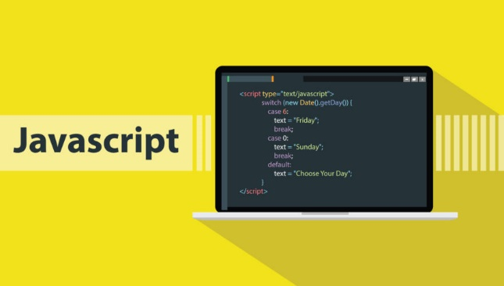
What is Javascript?
JavaScript is a programming language
that conforms to the ECMAScript specification.
JavaScript is high-level, often just-in-time compiled,
and multi-paradigm.
JavaScript has curly-bracket syntax, dynamic typing,
prototype-based object-orientation, and first-class functions.

Slide 12

What is PHP?
PHP is an acronym for "PHP: Hypertext Preprocessor"
PHP is a widely-used, open source scripting language
PHP scripts are executed on the server
PHP is free to download and use
PHP can generate dynamic page content
PHP can create, open, read, write, delete, and close files on the
server
PHP can collect form data
PHP can send and receive cookies
PHP can add, delete, modify data in your database
PHP can be used to control user-access
PHP can encrypt data

Slide 13
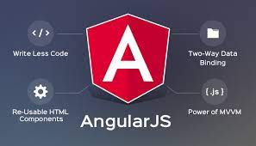
What is Angularjs?
AngularJS is a structural framework for dynamic web apps.
It lets you use HTML as your template language and lets you extend HTML's syntax to express your application's components clearly and succinctly.
AngularJS is data binding and dependency injection eliminate much of the code you would otherwise have to write.
And it all happens within the browser, making it an ideal partner with any server technology.

Slide 14

What is angular?
The Angular Language Service provides code editors.
It also provide a way to get completions, errors,
hints, and navigation inside Angular templates.
It works with external templates in separate HTML files
and also with in-line templates.

Slide 15

What is Laravel?
Laravel supports different language to be
used in application.
You need to store all the strings of different language
in a file and these files are stored
at resources/views directory.
You should create a separate directory for
each supported language.

Slide 16
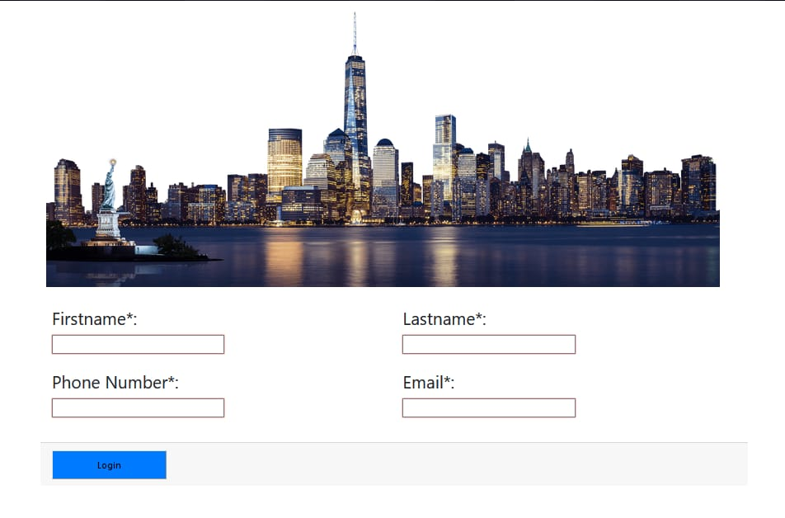
Problem Statement:
Q. Create login page

Slide 17
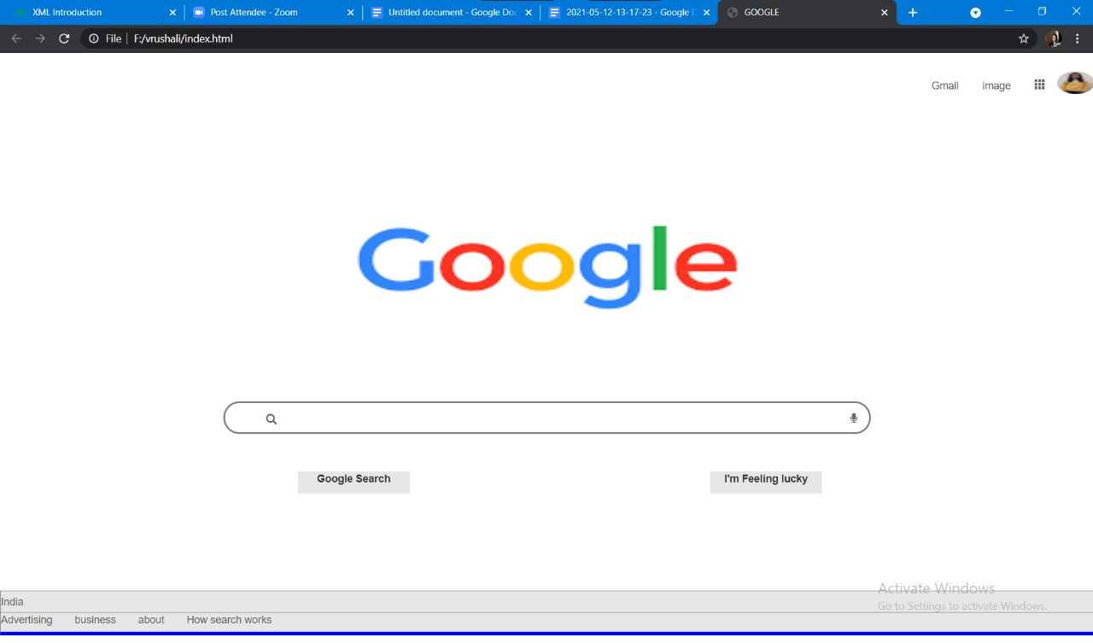
Q. Design Google Login Page Using HTML and CSS:

Slide 18
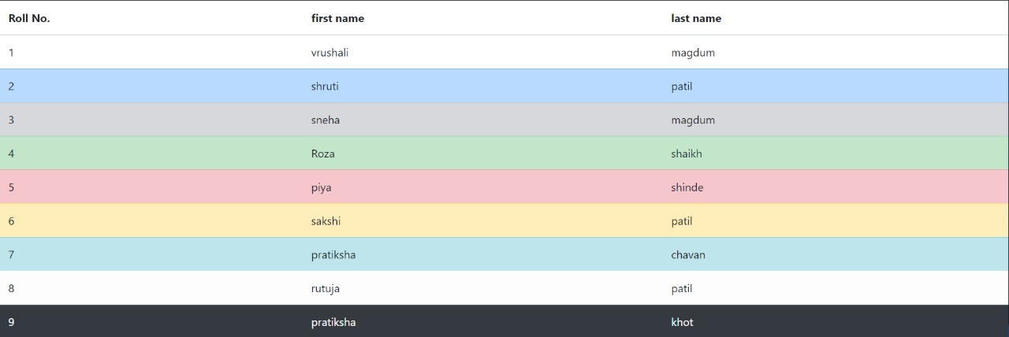
Q. Create stripped row from using Bootstrap:

Slide 19
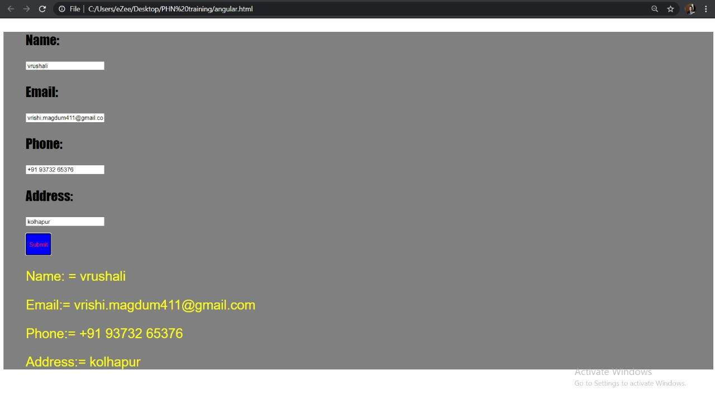
Q. Create Login page and display information on that page
using HTML and CSS,PHP:

Slide 20
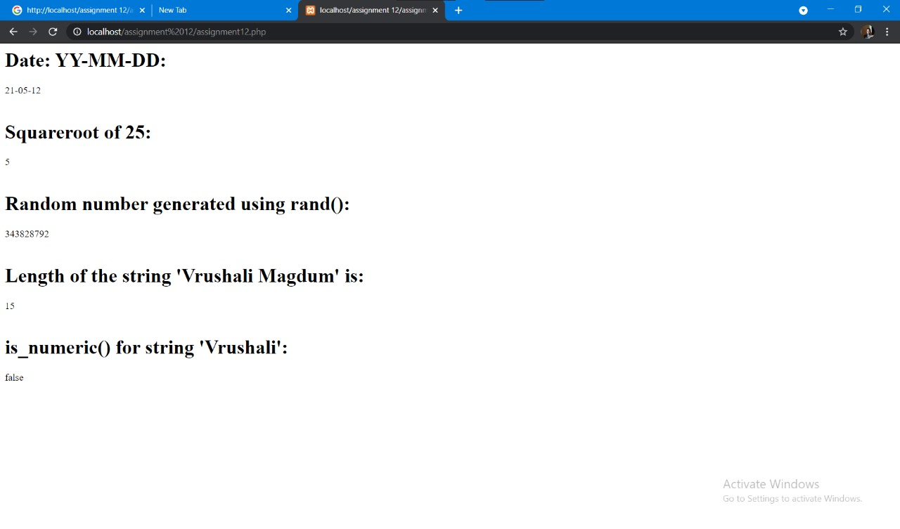
Q. Use of PHP Function:

Slide 21
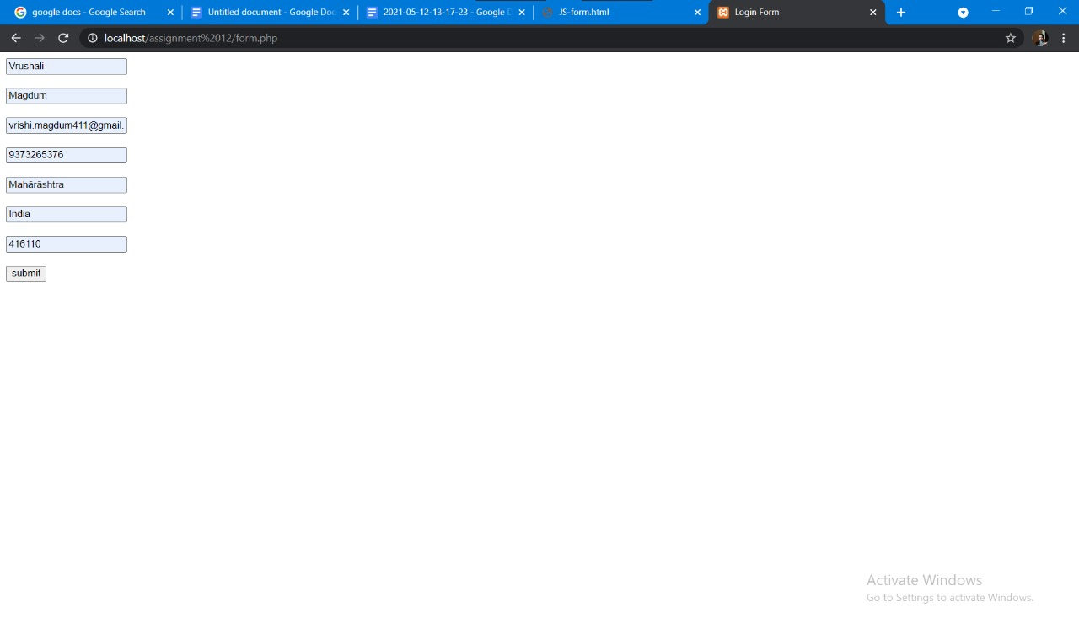
Q. Create Login From Using PHP :

Slide 22
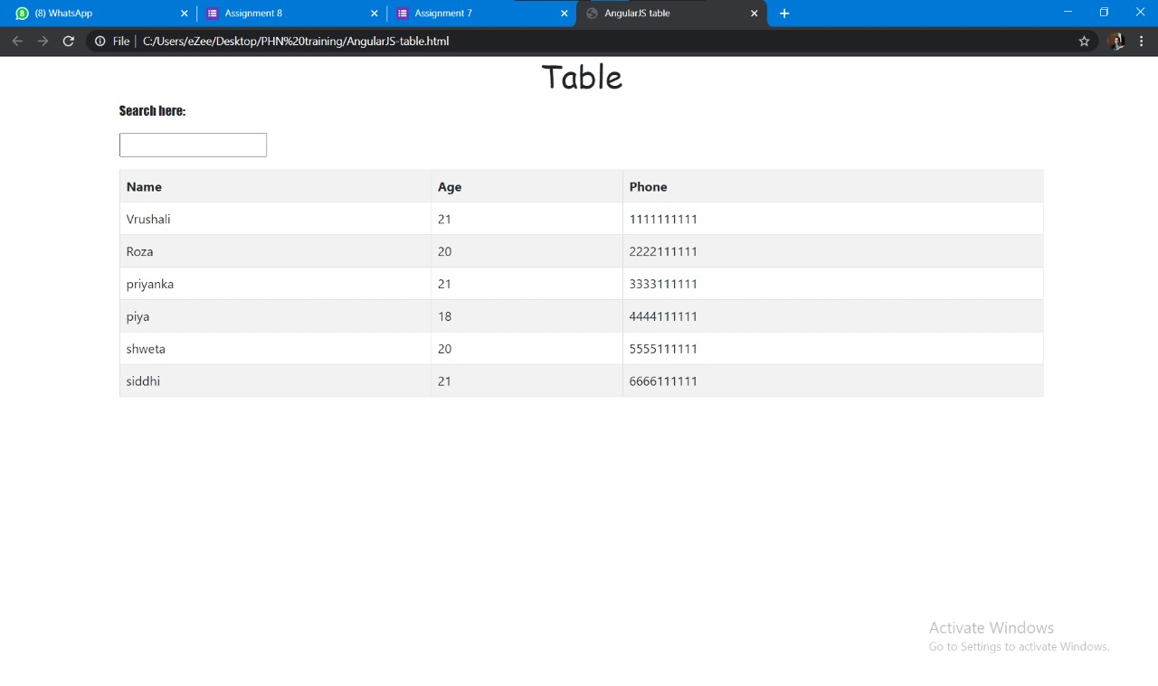
Q. Create table and search name on that table using CSS and Angular Js and HTML:

Slide 23
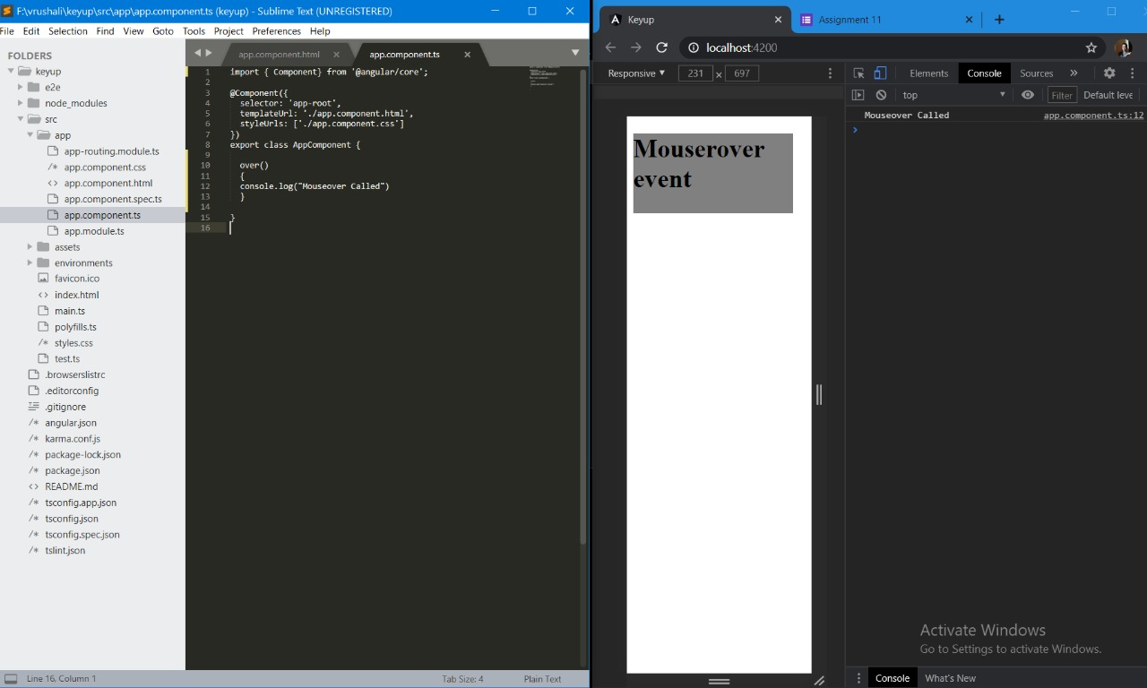
Q. Create Mouserover event using AngularJs:

Slide 24


